Slide 1

Introduction to MATLAB
MATLAB Programming
The MathWorks Inc.
Natick, MA
USA

Slide 2
Section Outline
Flow control and array operations
Performance increase
Function structural syntax
Variables and workspaces
Subfunctions
Visual debugging and profiling
Notes:
See:
Using MATLAB
Pages: Chapter 17
Section Outline
Flow Control and Array Operations
Performance Increase
Function Structural Syntax
Variables and Workspaces
Subfunctions
Visual Debugging and Profiling
We have seen MATLAB used in a command-driven mode. In this mode, you enter single-line commands. MATLAB processes these commands immediately and displays the results. MATLAB can also execute sequences of commands that are stored in files, which we call script M-files. Together, these two modes form an interpretive environment.
Disk files that contain MATLAB statements are called M-files because they have a file extension of .m. For example, a file named bessel.m would contain MATLAB statements that evaluate Bessel functions.
An M-file consists of a sequence of standard MATLAB expressions, which could include calls to other M-files. An M-file can call itself recursively. You can create M-files using a text editor or word processor.
Two types of M-files can be used: scripts and functions. Scripts, or script files, automate long sequences of commands. Functions, or function files, provide extensibility to MATLAB. They allow you to add new functions to the existing functions. Much of the power of MATLAB derives from this ability to create new functions that solve user-specific problems. Both functions and scripts are ordinary ASCII text files.

Slide 3
The MATLAB Path
MATLAB path:
  List of directories searched by MATLAB
  (Includes \toolbox directories)
Path cache:
  List of \toolbox files and locations
  Created at startup to increase speed
Working with the path:
  Path browser (PATHTOOL)
  path, addpath, rmpath
Notes:
The MATLAB Path
MATLAB Path
List of directories searched by MATLAB
(Includes \toolbox directories)
Path Cache
List of \toolbox files and locations
Created at startup to increase speed
Working with the Path
Path Browser (pathtool), path, addpath, rmpath
When you invoke an M-function file for the first time during a MATLAB session, it is compiled and placed into memory. At each subsequent function call, MATLAB checks the relative dates on the M-file and the function in memory. If the M-file has been updated, MATLAB recompiles the file.
When you call an M-file function from either the command line or from within another M-file, MATLAB parses the function and stores it in memory. This prevents MATLAB from having to reparse a function that has not changed during a session. The compiled function remains in memory until:
The timestamp of the saved file is newer than the timestamp of
the parsed version.
The function is cleared by using the clear command (type
help clear for more information).
MATLAB is shutdown.
Many functions provided with MATLAB are implemented as M-files, and these files are not typically changed. For this reason, directories under the MATLABR12\toolbox directory have their status cached (this is called the path cache). This means that modifications to these M-files do not get automatically detected during a MATLAB session. For this reason, it is recommended that you do not use MATLABR12\toolbox subdirectories to store your own M-file functions as these functions will not be updated until a new session of MATLAB is started.
Try:
>> path
>> pathtool
See:
Using MATLAB
Pages: 5-14 - 5-19

Slide 4
Flow Control Constructs
Logic control:
  if / elseif / else
  switch / case / otherwise
Iterative loops:
  for
  while
Notes:
Flow Control Constructs
These MATLAB commands provide structural constructs
for controlling the flow of logic within a program. They
will be discussed further in the slides which follow.
Logic Control:
if / elseif / else
switch / case / otherwise
Iterative Loops:
for
while
See:
Using MATLAB
Pages: 17-34 - 17-41

Slide 5
If, Elseif & Switch, Case Constructs
Works on conditional statements
Short-circuited in MATLAB - once a condition is true, or case matched, the sequence terminates
Switch, case statements are more efficient than elseif statements when working with strings
if I == J
A(I,J) = 2;
elseif abs(I-J) == 1
A(I,J) = -1;
else
A(I,J) = 0;
end
switch algorithm
case 'ode23'
str = '2nd/3rd order';
case {'ode15s', 'ode23s'}
str = 'stiff system';
otherwise
str = 'other algorithm';
end
>> if_examp
>> switch_examp
Notes:
if, elseif,else and
switch,case,otherwise
A conditional (Boolean) statement is an expression which
tests the validity of a specified condition (e.g., I==J).
The results are 1 for TRUE and 0 for FALSE.
MATLAB starts at the beginning of the if / elseif / else sequence and proceeds from one condition to the next. When it finds a true statement, it executes the appropriate section of the code, and then terminates the sequence. The last section of code is closed using the keyword end.
The switch statement is a convenient way to execute conditional code when you have many possible cases to choose from (not simply a TRUE/FALSE.) This construct can be used in place of a series of elseif statements. The code above shows a simple example of the switch statement. It checks the variable algorithm for certain values to determine which algorithm should be used. Only the first matching case is executed. This function could also be created using if / elseif / else commands.
Please note that the switch case construct runs more efficiently than if statements with string arguments because the string comparison is done in the MATLAB source, rather than with a function like strcmp.
C Programmers: Unlike in C, MATLAB’s switch does not “fall through.” That is, if the first case statement is TRUE, other case statements are not executed, so break statements are not used.
Try:
>> if_examp
>> switch_examp
if I == J
A(I,J) = 2;
elseif abs(I-J)==1
A(I,J) = -1;
else
A(I,J) = 0;
end
switch algorithm
case 'ode23'
str = '2nd/3rd order';
case {'ode15s', 'ode23s'}
str = 'stiff system';
otherwise
str = 'other algorithm';
end

Slide 6
For & While Loops
Similar to other programming languages
FOR -- Repeats loop a set number of times (based on index)
WHILE -- Repeats loop until logical condition returns FALSE
Can be nested
N = 10;
for I = 1:N
for J = 1:N
A(I,J) = 1/(I+J-1);
end
end
I = 1; N = 10;
while I <= N
  J = 1;
  while J <= N
    A(I,J) = 1/(I+J-1);
    J = J+1;
  end
  I = I+1;
end
>> for_examp
>> while_examp
Notes:
for and while Loops
N = 10;
for I = 1:N
for J = 1:N
A(I,J) = 1/(I+J-1);
end
end
The for loop repeats a section of code a set number of
times. for loops can be nested (one inside the other) and
each loop is closed with end.
I = 1; N = 10;
while I <= N
J = 1;
while J <= N
A(I,J) = 1/(I+J-1);
J = J+1;
end
I = I+1;
end
The while loop will continue to repeat a section of code
until its conditional statement is false (returns 0). while
loops can be nested (one inside the other) and each loop is closed with end.
Caution: When using while loops, watch out for infinite loops.
Can you think of an example where each of these would be used?
Try:
>> for_examp
>> while_examp

Slide 7
Performance Increase–vectorization
(Removal of FOR Loops)
Using loops (most languages):
M = rand(5,1000); L = rand(5,1000);
W = rand(5,1000); H = rand(5,1000);
[rows, cols] = size(M);
for I = 1:rows
for J = 1:cols
Density(I,J) = M(I,J)/(L(I,J)*W(I,J)*H(I,J));
end
end
Using Array Operations (MATLAB):
Density = M./(L.*W.*H);
>> array_vs_loops
Notes:
Performance Increase
Vectorization
Remember that MATLAB is designed to work with
matrices. In many cases, it is possible to use array
operations rather than using loops. This is highly
recommended as it increases the efficiency and
readability of the code.
Using Loops (most languages)
M = rand(5,1000); L = rand(5,1000);
W = rand(5,1000); H = rand(5,1000);
[rows, cols] = size(M);
for I = 1:rows
for J = 1:cols
Density(I,J)=M(I,J)/(L(I,J)*W(I,J)*H(I,J));
end
end
Using Array Operations (MATLAB)
Density = M./(L.*W.*H);
Try:
>> array_vs_loops
For more information on vectorizing code, in the Help Browser Search the Online Knowledge Base for “vectorize.”

Slide 8
Performance Increase–preallocation
Same resulting vector in both cases:
for I = 1:1000
not_pre_allo(I) = rand(1);
end
pre_allo = zeros(1000,1);
for I = 1:1000
pre_allo(I) = rand(1);
end
Preallocating variables creates a contiguous memory space (1000 elements), at the start
Stops MATLAB from finding 1000 different memory blocks of 1000 different sizes
>> pre_allocate
Notes:
Performance Increase
Preallocation
By preallocating a vector, MATLAB takes a contiguous
chunk of memory that will fit all (1000 in this example)
elements. It then places values in the correct spots.
However, if preallocation is not done. MATLAB must find a different contiguous memory block for each iteration of the for loop.
for I = 1:1000
not_pre_allo(I) = rand(1);
end
When I = 1 MATLAB will get a piece of memory that is 1 element long and place a random number in it.
When I = 2 MATLAB will get a new piece of memory that is 2 elements long and places the 1 random number from above in it, and a new random number in the second spot.
....
When I = 1000 MATLAB will get a new piece of memory that is 1000 elements long and places the 999 random numbers from above in it, and a new random number in the 1000th spot.
pre_allo = zeros(1000,1);
for I = 1:1000
pre_allo(I) = rand(1);
end
With preallocation, MATLAB gets a new piece of memory the size of 1000 elements, and then fills the array one element at a time.
Try:
>> pre_allocate
For more information on vectorizing code, in the Help browser, search the Online Knowledge Base for “vectorize.”

Slide 9
Functions
Core MATLAB (built-in) functions
  sin, abs, exp, ...
Matlab-supplied m-file functions
  mean, std, …
User-created m-file functions
  Wherever your imagination takes you...
Differences between script & function m-files
  Structural syntax
  Function workspaces, inputs & outputs
Notes:
Functions
All MATLAB operations are implemented by means of
functions. MATLAB provides a large number of standard elementary mathematical functions as well as many more advanced mathematical functions, for performing
numerical manipulations. For a list of some functions in
MATLAB, type
>> help elfun For elementary mathematical functions
>> help specfun For specialized mathematical functions
>> help elmat For elementary matrix manipulation
Some of the functions, like sqrt and sin, are built-in. They are part of the MATLAB core, so they are very efficient, but the code is not accessible. Other functions, like gamma and sinh, are implemented in M-files. You can read and modify the code. You can also add functions of your own.
Functions are useful for extending MATLAB (create your own MATLAB functions). Much of MATLAB’s power derives from this ability to create functions to solve specific problems.
Differences Between Script and Function M-Files
1. Structure
A function M-file must contain the keyword FUNCTION at the
beginning of the first line. There are also various other
structural standards that help to define functions.
2. Function Workspaces
A function does not work with variables in the base MATLAB
workspace. This prevents name conflicts between variables
defined by different functions and those defined at the
command line. As a result, all information to be transferred
between the MATLAB workspace and a function must be
passed as inputs and outputs.

Slide 10
Structure of a Function M-file
Keyword: function
Function Name (same as file name .m)
Output Argument(s)
Input Argument(s)
function y = mymean(x)
%MYMEAN Average or mean value.
% For vectors, MYMEAN(x) returns the mean value.
% For matrices, MYMEAN(x) is a row vector
% containing the mean value of each column.
[m,n] = size(x);
if m == 1
m = n;
end
y = sum(x)/m;
Online Help
MATLAB
Code
>> output_value = mymean(input_value)
Command Line Syntax
Notes:
Structure of a Function M-File
function y = mymean(x)
%MYMEAN Average or mean value.
% For vectors, MYMEAN(x) returns the
% mean value. For matrices, MYMEAN(x)
% is a row vector containing the mean
% value of each column.
[m,n] = size(x);
if m == 1
m = n;
end
y = sum(x)/m;
Required
Keyword: function
Function name (same as the file name)
File has a *.m extension
Optional
Input/Output argument(s) – These define the internal
variable names.
Online help – Comment lines following immediately after
the function definition line. (The first line in the Online
Help is referred to as the “H1” line. The lookfor
command uses the H1 lines in its search.)
MATLAB code – Contains the MATLAB expressions to
be executed as part of function.
Command Line Syntax
When calling a function from the command line, MATLAB searches the path for an M-file with the specified name (does not search for the function name in the file’s text).
Input variable name(s) defined in the first line of the function are used in the function code. The results produced by the function code must be stored in variable(s) with the same name as the output argument(s).
See:
Using MATLAB
Pages: 17-8 - 17-18
Try:
>> output_val = ...
mymean( input_val)

Slide 11
Multiple Input & Output Arguments
Multiple Output
Arguments [ , ]
Multiple Input Arguments ( , )
function [avg, stdev, r] = ourstats(x,tol)
% OURSTATS finds the "average", "standard
% Deviation", and "rank" of a matrix
[m,n] = size(x);
if m == 1
m = n;
end
avg = sum(x)/m;
stdev = sqrt(sum(x.^2)/m - avg.^2);
s = svd(x);
r = sum(s > tol);
>> [a,s,rank] = ourstats(1:99, 0.1);
Notes:
Multiple Inputs & Outputs
Any number of inputs and any number of outputs can be
used in combination with each other. The above example
has two inputs and three outputs, but the number of inputs
and outputs for any function M-File is not restricted to
certain combinations.
function [avg, stdev, r] = ourstats(x,tol)
% OURSTATS finds the "average", "standard
% deviation", and "rank" of a matrix
[m,n] = size(x);
if m == 1
m = n;
end
avg = sum(x)/m;
stdev = sqrt(sum(x.^2)/m - avg.^2);
s = svd(x);
r = sum(s > tol);
A function can also have a variable number of input and/or output arguments.
varagin - Variable length input argument list
varargout - Variable length output argument list
For more information refer to the Help browser.
Try:
>> [a,s,rank] = ...
ourstats(1:99,0.1);

Slide 12
Workspaces or Stacks in MATLAB
MATLAB (or base) workspace:
  For command line and script file variables.
Function workspaces:
  Each function has its own workspace for local variables.
  Communicate to function workspace via inputs & outputs.
  (Promotes structured coding & prevents name conflicts.)
Global workspace:
  Global variables can be shared by multiple workspaces.
  (Must be initialized in all relevant workspaces.)
Notes:
Workspaces or Stacks in
MATLAB
Each M-file function has an area of memory, separate from MATLAB’s base workspace, in which it operates. This
area is called the function workspace, with each function
having its own workspace context. While using MATLAB
the only variables you can access are those in the calling context, be it the base workspace or that of another function. The variables that you pass to a function must be in the calling context, and the function returns its output arguments to the calling workspace context. You can, however, define some variables as global variables explicitly, allowing more than one workspace context to access them.
MATLAB (or Base) Workspace
For command line and script file variables.
Function Workspaces
Each function has its own workspace for local variables.
Communicate to Function Workspace via inputs & outputs (promotes structured coding & prevents name conflicts).
Global Workspace
Global variables can be shared by multiple workspaces (must be initialized in all relevant workspaces).
Below are some functions related to working with M-file function workspaces.
mlock - Prevent M-file from being cleared
munlock - Allow M-file to be cleared
persistent - Persistent variables keep their value from one function call to another. They are removed only when the function is cleared from memory. However the M-file can be locked with mlock.
See:
Using MATLAB
Pages: 17-19 - 17-21

Slide 13
Inter-workspace Communication
Function inputs
And outputs
Global variables
MATLAB
Workspace
Function
Workspace
Global
Workspace
Initialize global variables in all relevant workspaces:
>> global variable_name
Initialize global variables in the “source” workspace before referring to them from other workspaces.
Notes:
Workspace Communication
Global variables are created using the global command.
The following process occurs when you type
>> global my_x
If a variable called my_x exists in the global workspace,
then its value is assigned to the local workspace’s variable my_x. Any existing local variable my_x has its value overwritten.
If no variable called my_x exists in the global workspace, but there is a variable my_x in the current workspace, then the local variable my_x is placed in the global workspace.
If no variable exists in the current workspace or the global workspace, then a new variable my_x is created and given the value [] (the empty matrix). This new variable is placed in the global workspace. The local variable and the global variable are then linked.
Note that there is opportunity for confusion here. Suppose my_x already exists in the MATLAB workspace (but is not global) and you want to access it from a function MyFun.
If you declare my_x global in MyFun first, then the global value for my_x becomes the empty matrix, []. You now have two variables named my_x (One is in the MATLAB workspace, one is a global variable that is also used by MyFun). If you then declare my_x global in the MATLAB workspace, the original variable is overwritten and its initial value is lost.
Declaring the variable global in the main MATLAB workspace first, and then in MyFun, does the right thing – the initial value for my_x is retained. Care must be taken to avoid this kind of mistake.

Slide 14
Tips for Using Global Variables
Avoid name conflicts (use capital letters)
whos global
clear global
isglobal()
Notes:
Tips on Using Global Variables
Use care when naming global variables. Since all functions
use the same global workspace, naming conflicts can easily
occur. To avoid this, use unique, descriptive variable
names for all global variables. Since variable names are
case sensitive, capitalization can also help. For example,
instead of using x, use Selected_X_Coord.
The commands clear, who, and whos normally apply to the current workspace. These commands take an optional argument, global, which specifies that the command should be applied to the global workspace. For example,
>> whos global
shows the contents of the global workspace
>> clear my_x
breaks the link between the local and global variables
(does not erase the global variable)
>> clear global my_x
erases the variable from both local and global workspaces
The isglobal function can be used to determine if a link exists between a local variable and the global workspace. This function does not determine if a variable exists in the global workspace; if the variable exists in the global workspace, but no link exists from a local variable, isglobal returns a zero (false).
For more information, in the Help browser, search the Online Knowledge Base for “global variables.”

Slide 15
Exercise 4.1: Function M-files
Given three lengths, determine if they create the sides of a valid triangle.
Write a function that has inputs of 3 lengths and outputs a string denoting if a triangle can or cannot be formed from the lengths provided.
NOTE: A triangle can only be formed if and only if the sum of any two sides is greater than that of the third.
Extra credit: denote if the triangle is an equilateral or isosceles triangle
Notes:
Exercise 4.1: Function M-Files
Given three lengths, determine if they create the sides of a
valid triangle.
Write a function that has inputs of three lengths and
outputs a string denoting if a triangle can or cannot be
formed from the lengths provided.
Note: A triangle can only be formed if and only if the sum of any two sides is greater than that of the third.
Extra credit: denote if the triangle is an equilateral or isosceles triangle

Slide 16
Solution Appears on Following Page.
Notes:
Solution appears on following page.

Slide 17
Solution 4.1: Function M-files
function str_out = istriangle(a,b,c)
vector = [a b c]; %Create a vector with the length of the sides
[long_side, index] = max(vector); %Length and index of the max value
%Sum of the shorter lengths
sum_short = sum([vector(1:index-1),vector(index+1:end)]);
%If the sum of the shorter sides is greater than the longest side
%that is a valid triangle
if sum_short > long_side
str_out = ['The sides ', num2str(vector), ...
' forms a valid triangle.'];
%Extra credit start
if (a == b) & (b == c) %All sides are equal
str_out = [str_out, char(10), ...
'The triangle is an equilateral triangle.'];
elseif (a == b) | (b == c) | (c == a) %Two sides are equal
str_out = [str_out, char(10), ...
'The triangle is an isosceles triangle.'];
end
%Extra credit end
>> str_out = istriangle(3,4,5)
Notes:
Solution 4.1: Function M-Files
function str_out = istriangle(a,b,c)
vector = [a b c];
%Create a vector with the length of
%the sides
[long_side, index] = max(vector);
%Length and index of the max value
%Sum of the shorter lengths
sum_short = sum([vector(1:index-1), vector(index+1:end)]);
%If the sum of the shorter sides is greater
%than the longest side that is a valid
%triangle
if sum_short > long_side
str_out = ['The sides ', num2str(vector), ...
' forms a valid triangle.'];
%Start extra credit
if (a == b) & (b == c) %All sides are equal
str_out = [str_out, char(10), ...
'The triangle is an equilateral triangle.'];
elseif (a == b) | (b == c) | (c == a) %Two sides are equal
str_out = [str_out, char(10), ...
'The triangle is an isosceles triangle.'];
end
%End extra credit
Try:
>> edit istriangle
>> str_out = ...
istriangle(3,4,5)

Slide 18
Solution 4.1: Function M-files
(Continued)
%Set the string to reflect that the sides do not form a valid
%triangle
else
str_out = ['The sides ', num2str(vector), ...
' do not form a valid triangle.'];
end
>> str_out = istriangle(3,4,5)
Notes:
Solution 4.1: Function M-Files
(Continued)
%Set the string to reflect that the
%sides do not form a valid triangle
else
str_out = ['The sides ', num2str(vector), ...
' do not form a valid triangle.'];
end

Slide 19
Subfunctions
Using subfunctions allows more than one function to be within the same m-file (modularize code).
M-files containing subfunctions must have the name of the first (primary) function.
Subfunctions can only be called from within the same m-file.
Each subfunction has its own workspace.
Notes:
Subfunctions
MATLAB M-files can contain code for more than one
function. The first function in the file is the primary
function, the function invoked with the M-file name.
Additional functions within the file are subfunctions and
can only be accessed from within the same M-file.
MATLAB looks for subfunctions before standard M-file
functions, so it will find a subfunction named mean.m before finding a nonprivate M-file named mean.m.
Each subfunction begins with its own function definition line. The functions immediately follow each other. The various subfunctions can occur in any order, as long as the primary function appears first.
See:
Using MATLAB
Pages: 17-42 - 17-43

Slide 20
Subfunctions (Example)
function [totalsum,average] = stats(input_vector)
% STATS - calculates cumulative total & average
totalsum = sum(input_vector);
average = ourmean(input_vector); %call to subfunction
function y = ourmean(x)
% OURMEAN - calculates average
[m,n] = size(x);
if m == 1
m = n;
end
y = sum(x)/m;
Primary
Function
Sub-
Function
>> [tsum, avg] = stats(rand(1,50))
Notes:
Try:
>> [tsum, avg] = ...
Stats(rand(1,50))
Subfunctions (Example)
Can you think of a use for subfunctions? Why would
they be useful?
function [totalsum,average] = stats(input_vector)
% STATS - Calculates cumulative total & average
totalsum = sum(input_vector);
average = ourmean(input_vector); %Call to subfunction
function y = ourmean(x)
% OURMEAN - Calculates average
[m,n] = size(x);
if m == 1
m = n;
end
y = sum(x)/m;
Primary
Function
Sub-
Function

Slide 21
MATLAB Calling Priority
High
Variable
Built-in function
Subfunction
Private function
Mex-file
P-file
M-file
Low
>> cos='This string.';
>> cos(8)
ans =
r
>> clear cos
>> cos(8)
ans =
-0.1455
Notes:
MATLAB Calling Priority
The way in which MATLAB looks for functions that you
call is determined by its dispatching priority. When
MATLAB comes upon a new name, it follows these steps:
1. Checks to see if the name is a variable.
2. Checks to see if the name is a built-in function.
3. Checks to see if the name is a subfunction (a MATLAB
function that resides in the same M-file as the calling function).
4. Checks to see if the name is a function residing in a private
directory (a directory accessible only to M-files in the directory
immediately above it).
5. Searches in order the directories on the MATLAB path for
MEX-files, P-files and M-files. In the event that all three are
found in the same directory, the priority order is MEX-files,
P-files then M-files.
If you are in doubt about the exact reference that will be used, issue the which command.
P-code (Pseudocode) files are created from M-files using the pcode command. Pseudocode is precompiled, ready-to-use code that MATLAB can access whenever you invoke the function. Because P-files are precompiled, their contents is invisible to the user, and in many cases they execute faster then the equivalent M-file.
Using the MEX function, MEX-files (MATLAB EXecutables) are created by compiling C or Fortran files into an executable form, which can be run within MATLAB. (See the Help browser for more information on MEX.)
Try:
>> cos = ...
‘This string’;
>> cos(8)
>> which cos
>> clear cos
>> cos(8)
See:
Using MATLAB
Pages: 17-12

Slide 22
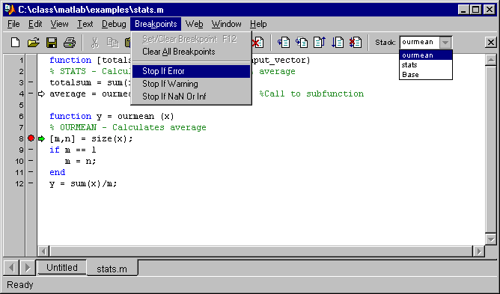
Visual Debugging
Select Workspace
Set Auto-
Breakpoints
Set Breakpoint
Clear Breaks
Step In
Single Step
Continue
Quit Debugging
>> [tsum, avg] = stats(rand(1,50))
Notes:
Visual Debugging
The MATLAB Editor/Debugger provides a number of
visual tools to assist in the debugging process:
Set breakpoints (either explicit or automatic).
Step through the execution of a function.
View the contents of the function’s workspace.
Set Breakpoint
Clear Breaks
Step In
Single Step
Continue
Quit Debugging
See:
Using MATLAB
Pages: 7-15 - 7-31

Slide 23
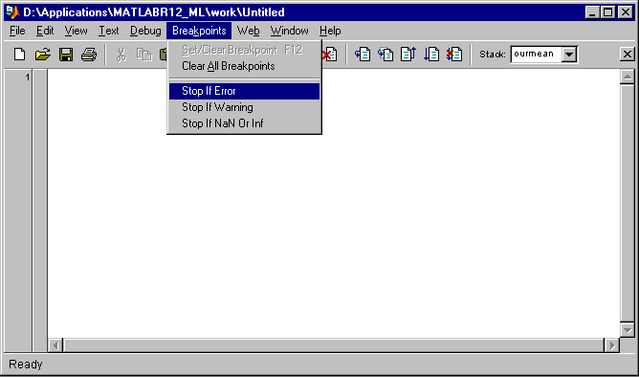
Example: Visual Debugging
Set up your debugger to stop if an error occurs
Then run:
>> [tsum, avg] = stats_error(rand(1,50))
Notes:
Visual Debugging (Example)
Set the debugger to stop if an error occurs while running a
function. Then run
>> [tsum, avg] = stats_error(rand(1,50))

Slide 24
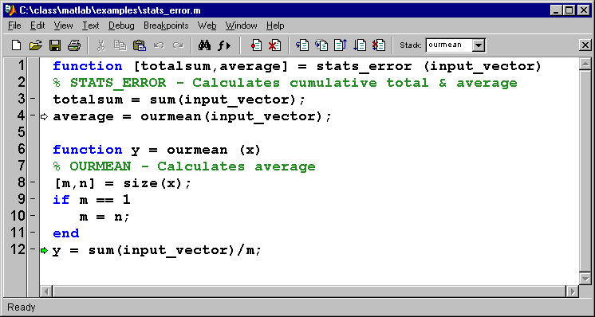
Example: Visual Debugging (2)
Editor/debugger opens the relevant file and identifies the line where the error occurred.
Current
Line
Current Workspace (Function)
Notes:
Visual Debugging (Example)
(Continued)
Since there is an error in the function, we are entered into
debug mode. The Editor/Debugger visually shows the
location of the error.
In the Debug menu, we can now choose to continue through the program, to step through the function line-by-line, or to quit debugging and edit the file. However, before we decide what to do next, we should take a look at the Command Window.
Current
Line
Current Workspace (Function)

Slide 25
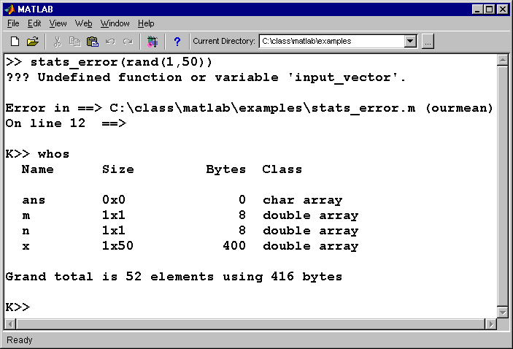
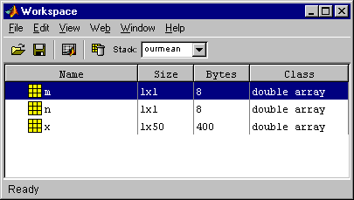
Example: Visual Debugging (3)
Error
message
Debug Mode
Access to Function’s Workspace
Notes:
Visual Debugging
Looking at the Command Window, we can see the error
message that caused line 12 to fail.
Undefined function or variable input_vector.
Because we are in debug mode (also referred to as keyboard mode - K>>), we now have access to the function workspace (using whos or the Workspace browser). You can select which workspace you want to view from the Editor/Debugger.
By observing the variable list, we can see that there is no variable called input_vector within the subfunction’s workspace, [stats_error(ourmean)]. Therefore, on line 12, the variable input_vector should actually be x. Once we make this minor change, the function runs without an error.
To exit debug mode, type
>> dbquit

Slide 26
Profiling M-files
Allows you to evaluate how much computation time each line of an m-file uses
Steps:
  Turn profiler on
  Call m-file
  Report results
  Turn profiler off
Notes:
Profiling M-Files
One way to ensure that your M-files run as efficiently as
as possible is to profile them. MATLAB provides an
M-file profiler that lets you evaluate how much
computation time each line of an M-file uses.
The profiler utility helps you debug and optimize M-files by tracking the cumulative execution time of each line of code. The utility creates a vector of bins, one bin for every line of code in the M-file being profiled. As MATLAB executes the M-file code, the profiler updates each bin with running counts of the time spent executing the corresponding line.
The profile command lets you access the profiler functionality through a simple command line interface. Its syntax is
>> profile keyword
where keywords include:
func_name to start profiling for the specified function
on, off, done, and reset to control the profiler’s operation
report to display a summary report for the M-file currently
being profiled
The profile command lets you specify the name of a function, subfunction, or private function to profile. This step automatically enables profiling for that function. There is no need to turn the profiler on unless you disable profiling and want to start it again.
See:
Using MATLAB
Pages: Chapter 8

Slide 27
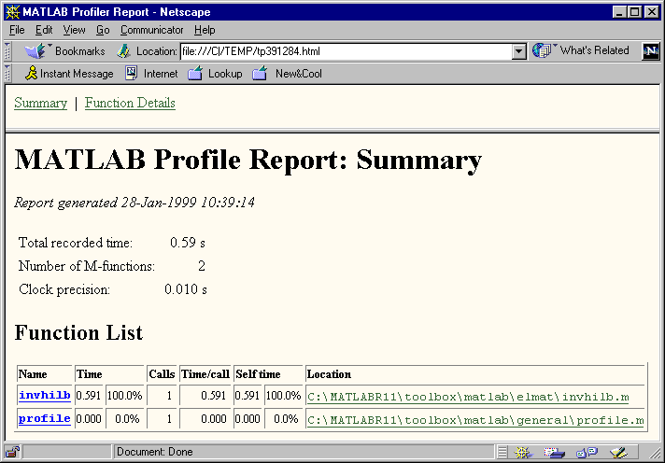
Profiling M-files (Example)
» profile on
» h = invhilb(50);
» profile report
» profile off
>> prof_m
Notes:
Profiling M-Files (Example)
>> profile on
>> h = invhilb(5);
>> profile report
>> profile off

Slide 28
Section Summary
Flow control and array operations
Performance increase
Function structural syntax
Variables and workspaces
Subfunctions
Visual debugging and profiling
Notes:
Section Summary
Flow Control and Array Operations
Performance Increase
Function Structural Syntax
Variables and Workspaces
Subfunctions
Visual Debugging and Profiling

